Slide 1

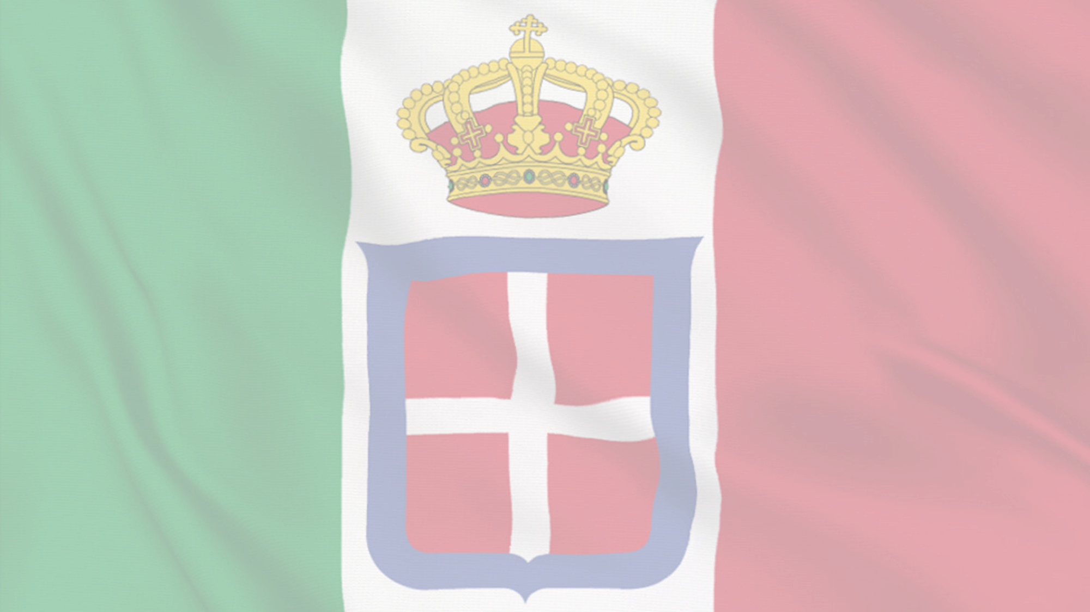


1921-1939
Chapter 23
LIFE IN FASCIST ITALY
life in fascist italy
Strand Three: The History of Europe and the Wider World
@MsDoorley

Slide 2
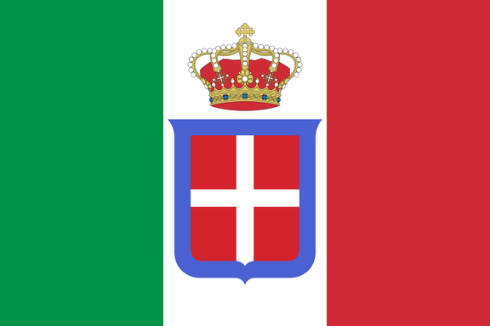
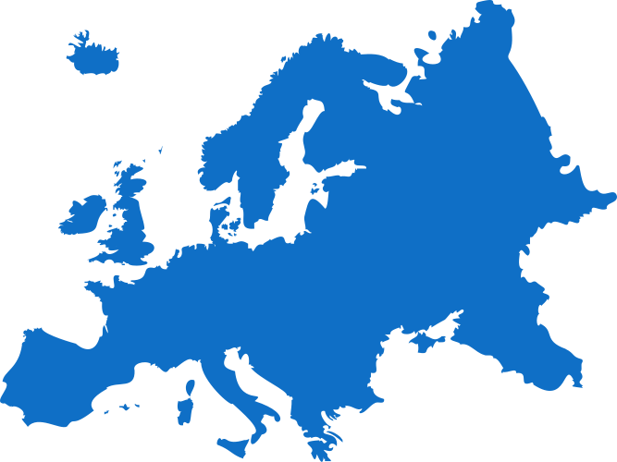

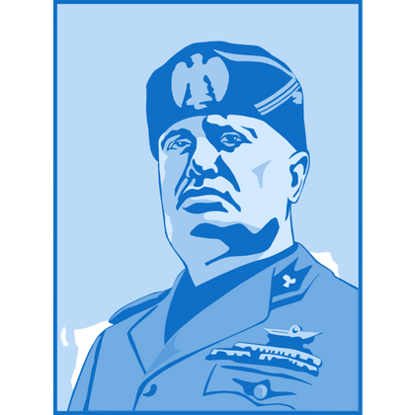
Chapter 23
LIFE IN FASCIST ITALY
3.9 EXAMINE life in one fascist country and one communist country in the twentieth century
March on Rome - Mussolini and his Blackshirts rise to power.
Giacome Matteotti assassinated due to opposition against Mussolini
The Rome-Berlin Axis Treaty is signed by Hitler and Mussolini.
Strand Three: The History of Europe and the Wider World
Chapter Twenty-Three: Life in Fascist Italy
1921
Oct 1922
1923
Jun 1924
Apr 1929
Oct 1936
1940
@MsDoorley
Benito Mussolini forms the National Fascist Party
Acerbo Law
Only the King could interfere with Mussolini's power
Lateran Treaty of Concordat give Mussolini an understanding with the Catholic Church.
Italy enters World War II as an Axis Power.

Slide 3
Learning Outcomes
3.9 EXAMINE life in one fascist country and one communist country in the twentieth century.
1.7 DEVELOP historical judgements based on evidence about personalities, issues and events in the past, showing awareness of historical significance.
1.9 DEMONSTRATE awareness of the significance of the history of Ireland and of Europe and the wider world across various dimensions, including political, social, economic, religious, cultural and scientific dimensions.
1.10 DEMONSTRATE chronological awareness by creating and maintaining timelines to locate personalities, issues and events in their appropriate historical eras.
Strand Three: The History of Europe and the Wider World
Chapter Twenty-Three: Life in Fascist Italy
@MsDoorley

Slide 4
Introduction
Italy, after the First World War, was in political and economic turmoil. The rise of Benito Mussolini and his Fascist Party marked a drastic shift in Italian politics, ultimately leading to Italy's transformation into a totalitarian state. Mussolini promised stability and resurgence for a nation scarred by war and political infighting but at the expense of personal freedoms and democratic principles.
Strand Three: The History of Europe and the Wider World
Chapter Twenty-Three: Life in Fascist Italy
@MsDoorley

Slide 5
1921-1939
Chapter 23
23.1: FASCISM AND ITALY
23.1: fascism and italy
Strand Three: The History of Europe and the Wider World
@MsDoorley

Slide 6
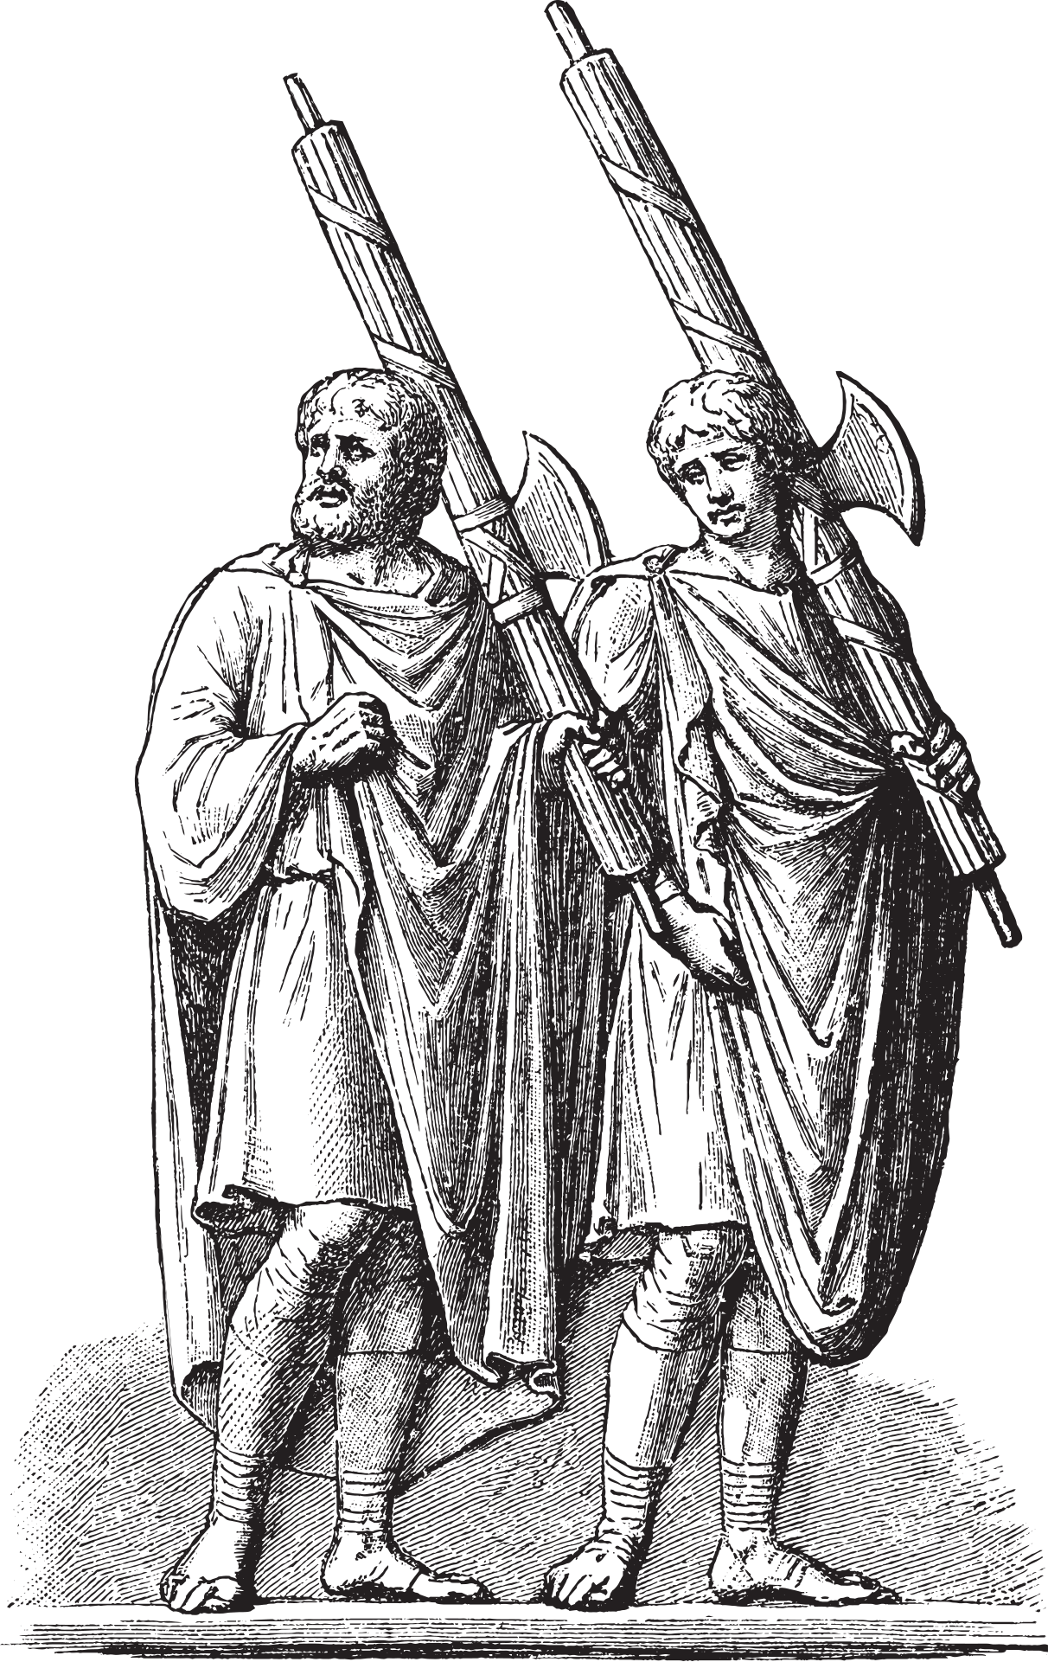

Fascism
Fascism is a political ideology that emerged in the first half of the twentieth century. It is a nationalistic right-wing system of government in which individual rights are subjugated to the authority of the state. The state is ruled by a dictator and political opposition is suppressed. The word fascism comes from the Latin word, fasces, which was the name given to a bundle of rods with an axe blade protruding. A symbol of strength and unity, it would become the symbol of the Italian Fascist Party.
After the end of WWI in November 1918, a number of conditions emerged in Europe that saw the rise of fascism:
  Anger at the post-war peace treaties.
  Economic turmoil because of inflation and high unemployment.
  Fear of the spread of communism.
  Weak democratic governments.
  The emergence of several charismatic leaders who won the support of both the middle and working classes.
Strand Three: The History of Europe and the Wider World
Chapter Twenty-Three: Life in Fascist Italy
@MsDoorley

Slide 7
The Birth of Fascism in Italy
The war left Italy in economic chaos, with skyrocketing unemployment and public unrest. The Fascist Party, founded by Benito Mussolini in 1919, sought to address these issues through a blend of nationalism, authoritarianism, and corporatism. Exploiting the widespread discontent and portraying themselves as Italy’s saviors, the Fascists gained traction quickly.
Mussolini and his Blackshirts, the paramilitary arm of the Fascist Party, organized and participated in violent confrontations against socialists, communists, and other political opponents. They presented themselves as the sole defenders of Italy's honor and traditions.
Strand Three: The History of Europe and the Wider World
Chapter Twenty-Three: Life in Fascist Italy
@MsDoorley

Slide 8
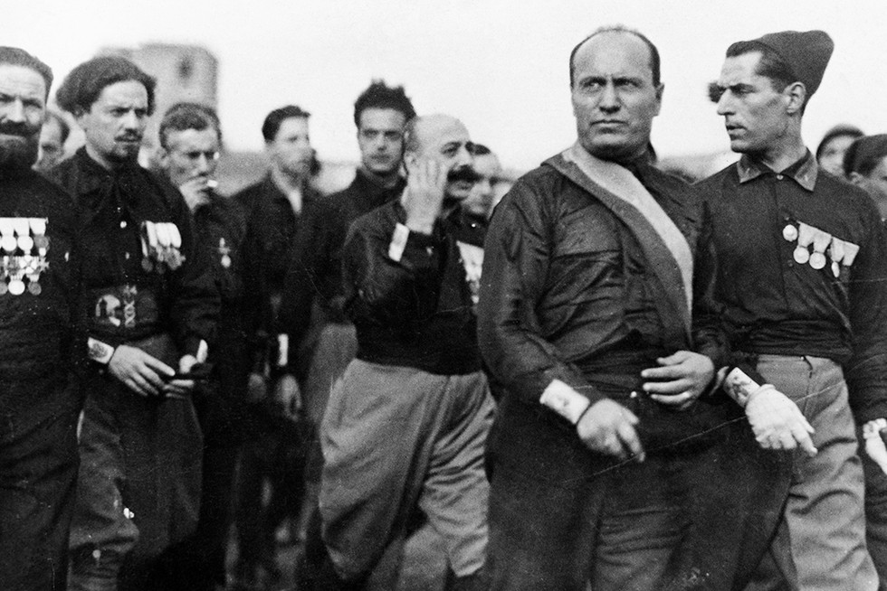
March on Rome and Mussolini's Rise to Power
In October 1922, thousands of Blackshirts marched on Rome, effectively staging a coup. King Victor Emmanuel III, fearing civil war and swayed by the popularity of the Fascists, invited Mussolini to form a government. Mussolini became Italy’s youngest-ever Prime Minister and immediately began consolidating his power.
Strand Three: The History of Europe and the Wider World
Chapter Twenty-Three: Life in Fascist Italy
@MsDoorley

Slide 9
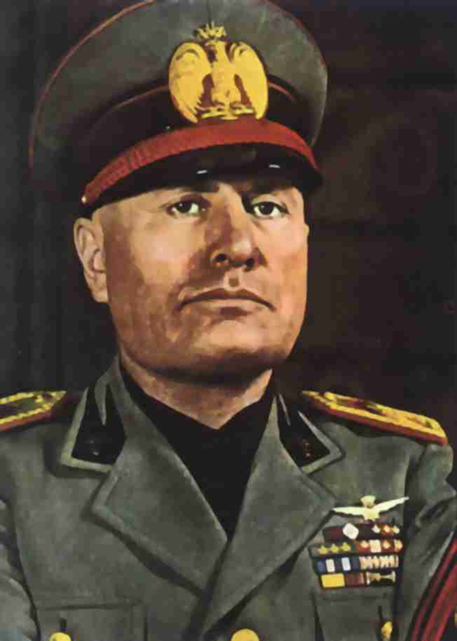
Benito Mussolini, 1883-1945
Benito Mussolini was born in Predappio, Italy. A former schoolteacher and journalist, Mussolini was initially aligned with socialist ideologies but shifted to the far right during and after World War I. In 1919, he founded the Fascist Party. His charismatic speeches, promises of national renewal, and violent suppression of opponents enabled him to become Italy’s premier in 1922. He established a totalitarian regime, emphasizing Italian nationalism, militarism, and anti-communism. In the late 1930s, he formed an alliance with Nazi Germany. Mussolini's aggressive foreign policies and role in World War II would eventually lead to his downfall. He was captured and executed by partisans in 1945.
Strand Three: The History of Europe and the Wider World
Chapter Twenty-Three: Life in Fascist Italy
@MsDoorley

Slide 10
Checkpoint 23.1
  Explain the following terms: fascism; Blackshirts; corporatism.
  Who was (a) King Victor Emmanuel III; (b) Benito Mussolini?
  How did Mussolini rise to power in 1922?
Strand Three: The History of Europe and the Wider World
Chapter Twenty-Three: Life in Fascist Italy
@MsDoorley

Slide 11
1921-1939
Chapter 23
23.2: LIFE UNDER MUSSOLINI
23.2: life under mussolini
Strand Three: The History of Europe and the Wider World
@MsDoorley

Slide 12
Life Under Mussolini
Mussolini, known as "Il Duce" (The Leader), implemented policies that strengthened the central government and suppressed opposition. The press was heavily censored, and political dissenters were imprisoned or sent to confinement in remote areas.
Economic policies were designed around the idea of corporatism, where representatives from business, labor, and the Fascist Party collaborated to set industry policies, leaving no room for strikes or lockouts. This pseudo-cooperative method was meant to stabilize Italy’s economy and prevent class conflict, though, in reality, it gave the state and the capitalists more control over workers.
Mussolini sought to create a new Roman Empire. This imperialistic ambition led Italy to invade and colonize regions in Africa, like Libya, and participate in international conflicts like the Spanish Civil War.
Strand Three: The History of Europe and the Wider World
Chapter Twenty-Three: Life in Fascist Italy
@MsDoorley

Slide 13
Economic Policies
  Corporate State: Mussolini aimed to create a corporate state, where the economy was organized by sectors (corporations) which included representatives from both employers and employees. The idea was to avoid class conflict and disputes, thereby harmonizing the needs of the workers with the needs of the state and industry.
  Battle for Grain: In an effort to make Italy more self-sufficient and less dependent on foreign imports, Mussolini initiated the "Battle for Grain" in 1925. The aim was to increase domestic grain production. By 1935, wheat production in Italy had increased substantially. However, this emphasis on grain production led to other agricultural sectors being neglected.
  Land Reclamation: Vast projects were undertaken to reclaim marshlands and turn them into arable farmland. The Pontine Marshes near Rome were one of the most notable reclamation projects.
  Industrial Growth: Mussolini was keen on industrial growth and viewed it as a measure of national strength. His government invested in infrastructure projects like roads and railways. This, in turn, led to a growth in industries related to transport, such as automobile and steel production. The autostrada, a network of highways, was one such achievement.
  Protectionism: In order to safeguard and stimulate the Italian economy, Mussolini's government raised tariffs on imported goods, encouraging people to buy domestic products.
Strand Three: The History of Europe and the Wider World
Chapter Twenty-Three: Life in Fascist Italy
@MsDoorley

Slide 14
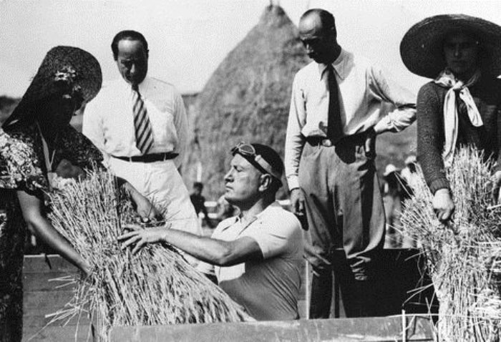
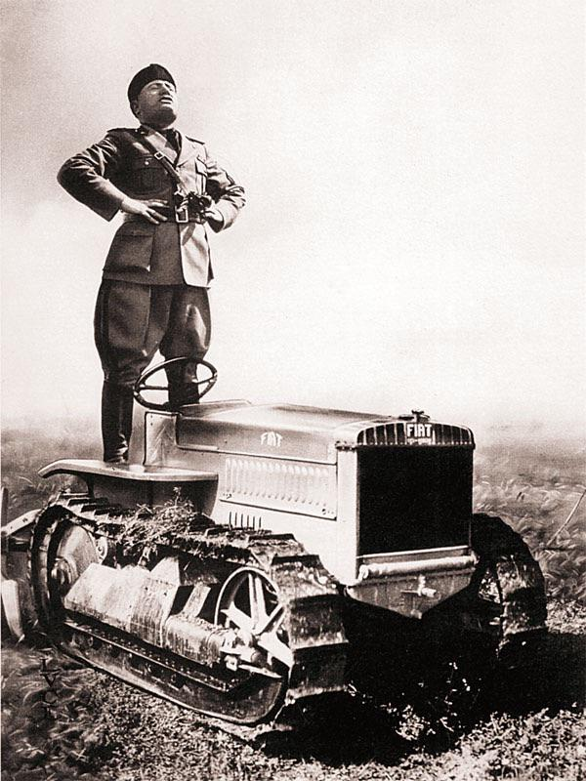
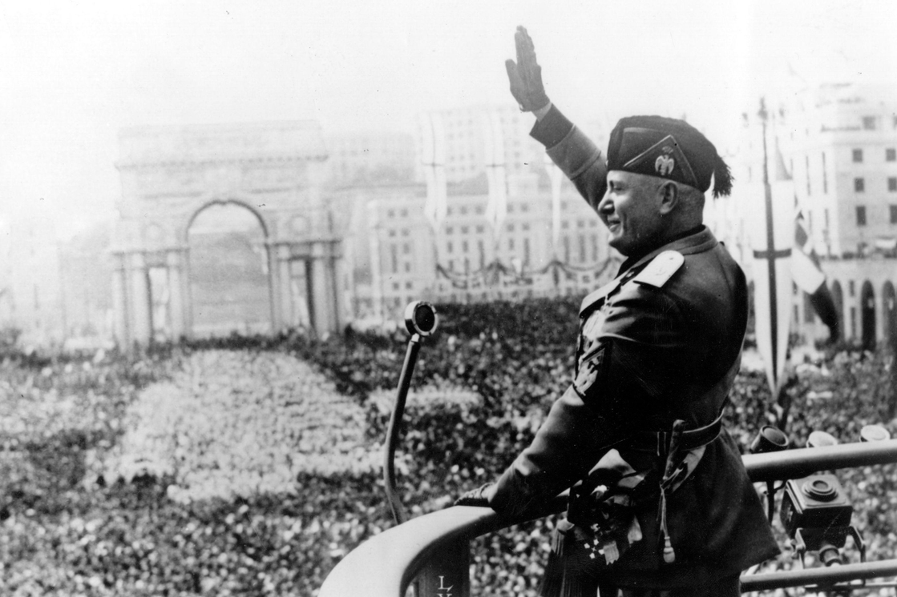
Strand Three: The History of Europe and the Wider World
Chapter Twenty-Three: Life in Fascist Italy
@MsDoorley

Slide 15
Economic Policies
  State Intervention and Control: Mussolini did not shy away from direct state intervention in the economy. By the mid-1930s, the state had control over a vast portion of the Italian economy, either directly or through government-controlled entities.
  Dependence on Germany: While Mussolini aimed for self-sufficiency, Italy's economy increasingly became dependent on trade with Nazi Germany, especially after Italy's invasion of Abyssinia led to international sanctions.
  Living Standards and Wages: Despite all the economic activities and efforts to increase production, the living standards for the average Italian did not rise significantly under Fascist rule. Wages remained relatively stagnant, and the living conditions for many were challenging.
  Public Works: Many public works projects were initiated to provide employment. Notably, the draining of marshes and the construction of new roads and buildings were heralded as symbols of the new Fascist Italy.
Strand Three: The History of Europe and the Wider World
Chapter Twenty-Three: Life in Fascist Italy
@MsDoorley

Slide 16
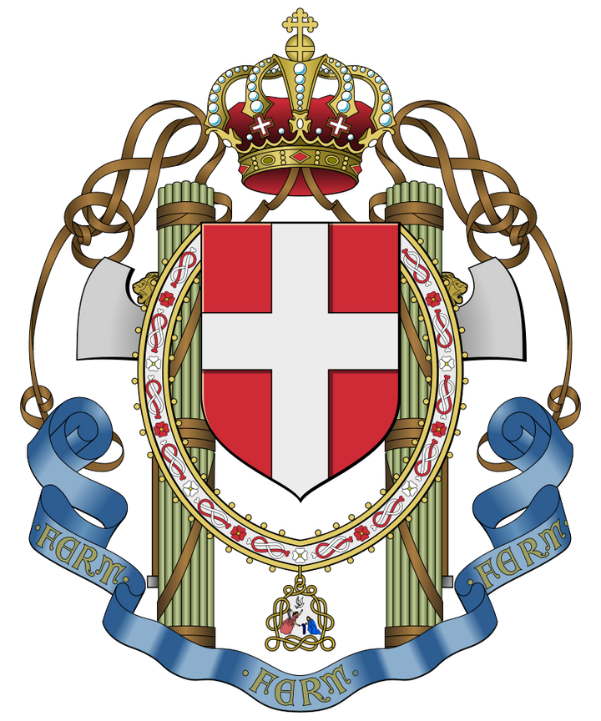
Terror
In Fascist Italy, Mussolini maintained his regime's stability and his own grip on power through terror, transforming Italy into a totalitarian state.
  OVRA, Mussolini's secret police, kept watch on Italians and arrested thousands for political "crimes". They acted as a tool of intimidation, ensuring citizens did not speak or act against the Fascist regime.
  Similar to the USSR's gulags, Italy had its own confinement system. Political prisoners, including known anti-Fascists, were sent to remote islands or internment camps.
Strand Three: The History of Europe and the Wider World
Chapter Twenty-Three: Life in Fascist Italy
@MsDoorley

Slide 17
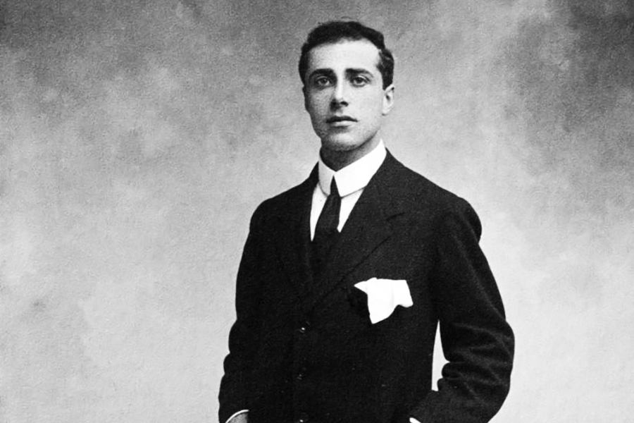
The Matteotti Crisis and Subsequent Purges
Mussolini's regime faced significant challenges. In 1924, Giacomo Matteotti, a socialist deputy, publicly criticized the Fascists for electoral fraud and was later kidnapped and murdered by Fascists. The event almost toppled Mussolini but instead led him to consolidate power even further.
After the Matteotti crisis, Mussolini initiated a series of purges, removing potential threats from within his party and the government. This 'clean-up' mirrored Stalin's tactics, ensuring unquestionable loyalty to Il Duce.
Strand Three: The History of Europe and the Wider World
Chapter Twenty-Three: Life in Fascist Italy
@MsDoorley

Slide 18
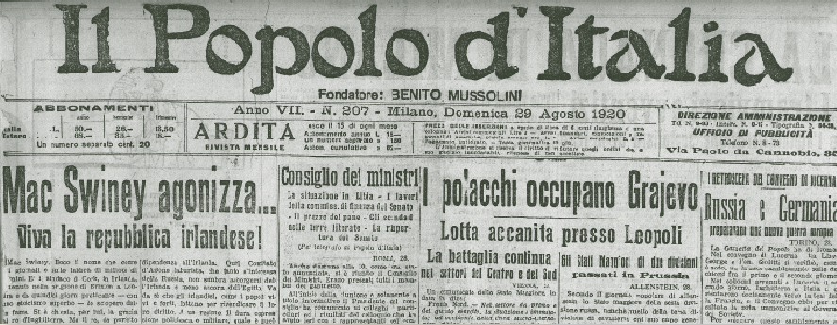
Propaganda
Propaganda was an essential tool for Mussolini.
  Mussolini controlled the press, ensuring that the Fascist message was consistently promoted. Newspapers like the Popolo d'Italia praised Fascism and Mussolini.
  Through art, cinema, and radio, the Fascist regime promoted an image of a strong, unified, and rejuvenated Italy.
  Mussolini portrayed himself as the nation's savior, with images of him everywhere, cultivating a 'cult of personality'.
  Key historical events were manipulated or rewritten to extol the virtues of Fascism and Mussolini's central role in Italy's revival.
Strand Three: The History of Europe and the Wider World
Chapter Twenty-Three: Life in Fascist Italy
@MsDoorley

Slide 19
Winning the Church
Mussolini's relationship with the Roman Catholic Church is a defining aspect of his reign, marked most significantly by the signing of the Lateran Treaty in 1929. Recognizing the Church's profound influence in Italy, Mussolini sought to win its favor, both to legitimize his regime and to unify the nation under Fascism. The Lateran Treaty resolved the longstanding "Roman Question," granting the Vatican City independent nation status, ensuring papal sovereignty, and providing financial compensation for the Papal States' loss in 1870. In return, Catholicism was declared Italy's state religion, religious instruction became mandatory in schools, and the Church gained a say in many family law matters. This alliance bolstered Mussolini's image, portraying him as a leader who reconciled modernity with tradition, ensuring the Church's acquiescence to his rule. The Church, in return, received assurances of its central role in Italian society, solidifying a mutually beneficial relationship between the Fascist state and the Vatican.
Strand Three: The History of Europe and the Wider World
Chapter Twenty-Three: Life in Fascist Italy
@MsDoorley

Slide 20
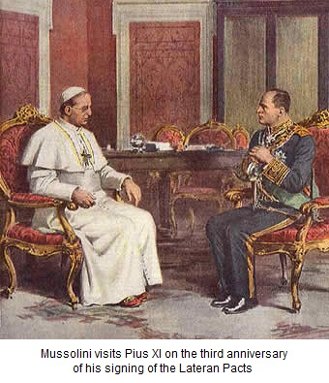
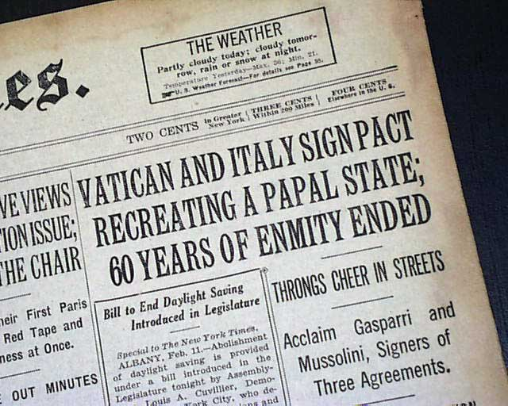
Strand Three: The History of Europe and the Wider World
Chapter Twenty-Three: Life in Fascist Italy
@MsDoorley

Slide 21
Education
Propaganda was not limited to media; it was infused into Italy's education system.
  School curricula were modified to promote Fascist ideologies, focusing on nationalistic and militaristic values.
  Mussolini wanted to create a new generation of Italians devoted to the state and introduced mandatory youth organizations like the Balilla and Piccole Italiane.
Strand Three: The History of Europe and the Wider World
Chapter Twenty-Three: Life in Fascist Italy
@MsDoorley

Slide 22
Women's Lives Under Mussolini
Under Fascist rule, traditional gender roles were reinforced. Women were seen primarily as mothers and homemakers. Mussolini viewed the increase of the Italian population as crucial for his new empire, so policies encouraged women to have large families. Despite this, women were still active in various sectors of society, though often in limited or subservient roles.
Strand Three: The History of Europe and the Wider World
Chapter Twenty-Three: Life in Fascist Italy
@MsDoorley

Slide 23
Checkpoint 23.2
  List two policies Mussolini implemented once in power.
  What is propaganda? Give three examples of how it was used by Mussolini.
  Why do you think dictatorships need to use propaganda?
  How did Mussolini's educational reforms promote Fascism?
  Did Mussolini's policies encourage traditional family values in Italy?
  Compare Mussolini's views on women to those of traditional Italian society. Explain your answer.
  How did Fascist rule impact the lives of Italian women?
Strand Three: The History of Europe and the Wider World
Chapter Twenty-Three: Life in Fascist Italy
@MsDoorley

Slide 24
Checkpoint 23.2
  The Acerbo Law and the Lateran Treaty of Concordat
  Propaganda is the deliberate control of information that is given to the public to influence opinions. Radio, newspapers, education.
  To keep themselves in power.
  It taught fascism to children from a young age to indoctrinate them.
  Yes, they encouraged traditional life.
  Mussolini’s view was very similar, with the expectation for women to have many children to build up the workforce.
  While women could work in some parts of society, it restricted them to the household in a very Catholic influenced household where the woman’s main role in society was to have children.
Strand Three: The History of Europe and the Wider World
Chapter Twenty-Three: Life in Fascist Italy
@MsDoorley

Slide 25
1917-1939
Chapter 23
23.3: SUMMARY
23.3: summary
Strand Three: The History of Europe and the Wider World
@MsDoorley

Slide 26
In this chapter, we have learned that...
  Benito Mussolini's rise to power following Italy's post-WWI political instability.
  The establishment of Fascist Italy and the methods Mussolini used to maintain and consolidate his rule, including terror, purges, and propaganda.
  The profound impact of Fascism on Italy's social, political, and cultural fabric, from the suppression of dissenting voices to the promotion of nationalistic values.
  Under Mussolini, Italy experienced increased control over every facet of public life, from the press to the educational system.
  Mussolini's policies on gender roles and the family, emphasizing traditional values and the importance of motherhood.
Strand Three: The History of Europe and the Wider World
Chapter Twenty-Three: Life in Fascist Italy
@MsDoorley

Slide 27
Reflecting on... Life in Fascist Italy
Mussolini's Fascist regime promised stability and national pride to an Italy scarred by war and political fragmentation. While achieving rapid modernization and asserting Italy on the global stage, the cost was high in terms of personal freedoms, democratic principles, and human lives. The tensions between Fascism, communism, and Western democracies set the stage for the larger ideological battles of the 20th century.
Strand Three: The History of Europe and the Wider World
Chapter Twenty-Three: Life in Fascist Italy
@MsDoorley

Slide 28
Examination Questions
2022 SEC Q4
Strand Three: The History of Europe and the Wider World
Chapter Twenty-Three: Life in Fascist Italy
@MsDoorley

Slide 29
Keywords Test
You have 5 mins to go over your keywords.
First 10 keywords.
Strand Three: The History of Europe and the Wider World
Chapter Twenty-Three: Life in Fascist Italy
@MsDoorley

Slide 30
Keywords Test
  a system of government where the state controls all aspects of the economy (property, business and jobs) and of society, with limited rights for Individuals
  Party who receives most votes gets 2/3s of seats in Parliament
  Right Wing Fascist Nationalists
  22 Government departments set up to manage the country
  Nickname for the Italian Fascists
  Removed any negative publicity
  Motorways built throughout Italy
  Action to overthrow the government in power
  Leader of the Fascist Party in Italy
  Grew more wheat for making bread and pasta widely available
  Acerbo
  Autostrada
  Battle for Grain
  Benito Mussolini
  Blackshirts
  Censorship
  Communism
  Corporate State
  Coup D’état
  Falange
Strand Three: The History of Europe and the Wider World
Chapter Twenty-Three: Life in Fascist Italy
@MsDoorley

Slide 31
Keywords Test
  a system of government where the state controls all aspects of the economy (property, business and jobs) and of society, with limited rights for Individuals - Communism
  Party who receives most votes gets 2/3s of seats in Parliament - Acerbo
  Right Wing Fascist Nationalists - Falange
  22 Government departments set up to manage the country - Corporate State
  Nickname for the Italian Fascists - Blackshirts
  Removed any negative publicity - Censorship
  Motorways built throughout Italy - Autostrada
  Action to overthrow the government in power - Coup D’état
  Leader of the Fascist Party in Italy - Benito Mussolini
  Grew more wheat for making bread and pasta widely available - Battle for Grain
Strand Three: The History of Europe and the Wider World
Chapter Twenty-Three: Life in Fascist Italy
@MsDoorley

Slide 32
Project
Guidelines:
  Length: The depth of your project should reflect about 2-3 weeks of work.
  Sources: Use at least three different sources for your research. These can be books, scholarly articles, or reputable online resources.
  Citations: All information and images that are not your own should be properly cited.
  Mediums: You may choose to present your project in one of the following ways:
    Poster: Your poster should be informative and visually engaging.
    Minecraft or Lego Model: If choosing this option, please also include a brief report explaining your model.
    Painting/Drawing: Your artwork should be accompanied by a description.
    Recycled Materials: Create your model using recycled materials and provide an explanation of your creative process.
Assessment:
Your projects will be assessed based on:
  Research and Content
  Creativity and Presentation
  Understanding of Context
  Adherence to Guidelines
Strand Three: The History of Europe and the Wider World
Chapter Twenty-Three: Life in Fascist Italy
@MsDoorley

Slide 33
Project
Historical Sites
Historical Figures
Palazzo Venezia, Rome, Italy
Piazzale Loreto, Milan, Italy
Fiat Lingotto Factory, Turin, Italy
Ostia Lido, Rome, Italy
Predappio, Forlì-Cesena, Italy
Benito Mussolini
Giovanni Gentile
Roberto Farinacci
Emilio De Bono
Luigi Albertini
Giovanii Amendola
Strand Three: The History of Europe and the Wider World
Chapter Twenty-Three: Life in Fascist Italy
@MsDoorley

